Slide 1





Module 03- Flow control
WWW.SELACLOUD.COM

Slide 2

Agenda
Relational and Logical Operators
If statement
While loop
For loop
Loop Control Statements

Slide 3
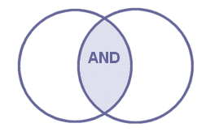

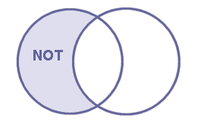
Relational and Logical Operators
Logical Operators:
Logical AND Logical OR Logical NOT
Two sets of relational operators:
Example Expression | Relational operator | Symbol
result = val2 == val3 | Is val2 equal to val3? | ==
result = val2 != val3 | Is val2 not equal to val3? | !=
result = val2 > val3 | Is val2 greater than val3? | <
result = val2 =< val3 | Is val2 greater than or equal to val3? | =<
result = val2 < val3 | Is val2 smaller than val3? | >
result = val2 => val3 | Is val2 smaller than or equal to val3? | =>
Notes:
The English mathematician George Boole’s work in the mid-nineteenth-century formed the basis of Boolean logic.
The bool type
A type that represents the following set of values: {true, false}.
A variable of this type is often used to record the result of some operation (in many cases a comparison operation), so that we can act on that result.
As an example, consider we want to check if a password is longer than 4 characters.
To do this, we need some indication of whether the statement “password length is greater than 4” is true or false.
That is, we need to know the Boolean result of this comparison.
Boolean Expression
An expression whose value is either true or false.
A Boolean expression may contain a relational operator to bestow it its Boolean nature.
Relational Operator (also known as Comparison Operator)
An operator (representation of an operation) aimed at comparing its operands against each other (see table in the slide).
These operators are built-in, in most of the available programming languages.
Without the comparison ability, programming is unimaginable, and these operators intuitively represent that ability.
Note: None of the above is to be confused with the term logical operator which will be discussed later in this chapter.
For further reading:
http://www.kerryr.net/pioneers/boole.htm
http://en.wikipedia.org/wiki/George_Boole
http://www-groups.dcs.st-and.ac.uk/~history/Biographies/Boole.html

Slide 4
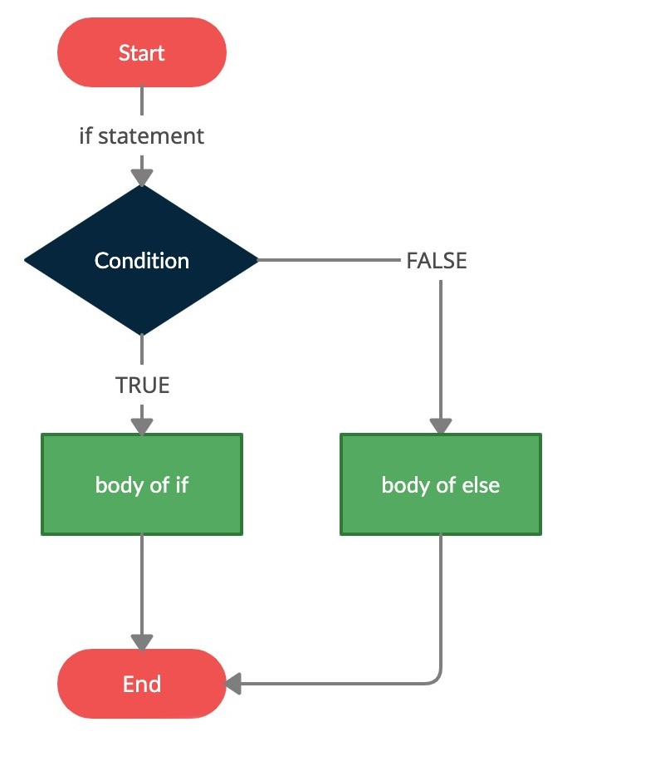
If statment
if statement1:
…
elif statement2:
……..
else:
……
elif and else statements are optional
Example:
number = 10 if number %2 == 0: print ("The number is even") else: print ("The number is odd")
Notes:
A program becomes flexible when the execution of an operation or a series of operations becomes dependent on specific circumstances.
We use conditions:
To check the values of variables – and act differently on different values.
To check input validity – and act differently on valid input than invalid input.
To check a graphic object’s properties.
And more…

Slide 5
If Demo

Slide 6
# A simple program to check if a number is positive or negative number = int(input("Enter a number: ")) if number > 0: print("The number is positive.") elif number < 0: print("The number is negative.") else: print("The number is zero.")
In this example, the program asks the user to enter a number. It then uses the if statement to check whether the number is positive, negative, or zero. If the number is greater than zero, it prints "The number is positive." If the number is less than zero, it prints "The number is negative." Otherwise, if the number is zero, it prints "The number is zero."
Notes:
A program becomes flexible when the execution of an operation or a series of operations becomes dependent on specific circumstances.
We use conditions:
To check the values of variables – and act differently on different values.
To check input validity – and act differently on valid input than invalid input.
To check a graphic object’s properties.
And more…

Slide 7
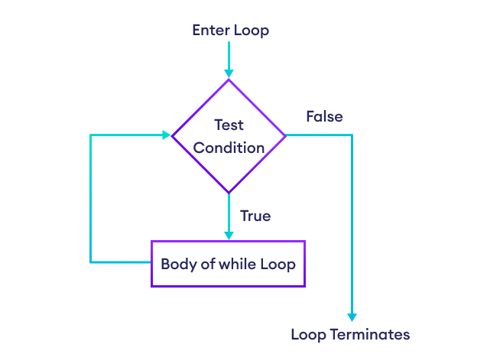
While loop
Python while loops are used for repeating sections of code - but unlike a for loop, the while loop will run as long as defined condition is met.
while expression:
statement(s)
Example 1:
Example 2:
count = 0 while count < 9: print ('The count is:', count) count += 1
n = input("Please enter 'hello':") while n.strip() != 'hello': n = input("Please enter 'hello':")
Notes:
Explanation:
First, the statement is checked.
If it is true, that is, if its value is true, the command block is executed.
Regardless if the statement is true or false, the program continues and executes the commands following the command block.
Indentation – the command block is indented to the right.
Note: the code that is executed if the statement is false, is also executed if the statement is true.
To illustrate consider the following:
All students who passed the final exams deserve a diploma.
But, if a student passed at a certain grade (say, 90 or more), he or she deserves another certificate for their excellence.
So, the program will check if a student excelled – if so, it will issue the appropriate certificate – and then unconditionally reward them with a diploma.

Slide 8
While Demo

Slide 9
# A program to print numbers from 1 to 5 using a while loop number = 1 while number <= 5: print(number) number += 1
In this example, the program uses a while loop to print numbers from 1 to 5. The loop continues as long as the number variable is less than or equal to 5. Inside the loop, the current value of number is printed, and then the number variable is incremented by 1 using number += 1.
When you run this code, it will output:
1
2
3
4
5
Notes:
A program becomes flexible when the execution of an operation or a series of operations becomes dependent on specific circumstances.
We use conditions:
To check the values of variables – and act differently on different values.
To check input validity – and act differently on valid input than invalid input.
To check a graphic object’s properties.
And more…

Slide 10
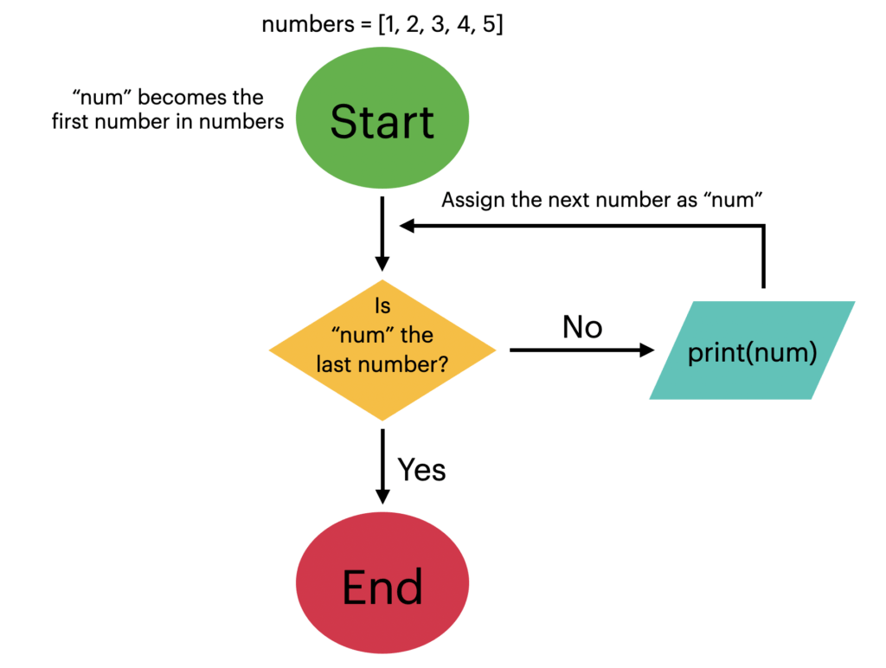
For Loop
Python for loops iterates over the member of a sequence in order
Example 1:
Example 2:
Example 3:
for letter in 'sentence': print (letter) #prints: s e n t e n c e
for num in range(10,20): #prints 10, 11, 12 …19 print(num)
for num in range(10,21, 2): #prints 10, 12, 14 …20 print(num)
Notes:
Example 1
If the balance equals zero (the statement value is True), display: “No money left...”
Example 2
Is the number divisible by 7?
If the statement ((num % 7) = = 0) value is true, display “Can be divided by 7”
Note: The whole Boolean expression is evaluated (either as true or false).
Non-Boolean variables may be included in the expression.
What gives the expression is Boolean nature, in this case, is the usage of the comparison operator.

Slide 11
For Demo

Slide 12
# A program to print the elements of a list using a for loop fruits = ["apple", "banana", "cherry", "date", "elderberry"] for fruit in fruits: print(fruit)
In this example, the program uses a for loop to iterate over the elements of the fruits list. For each iteration, the current element is assigned to the variable fruit, and then it is printed using the print statement.
When you run this code, it will output:
apple
banana
cherry
date
elderberry
Notes:
A program becomes flexible when the execution of an operation or a series of operations becomes dependent on specific circumstances.
We use conditions:
To check the values of variables – and act differently on different values.
To check input validity – and act differently on valid input than invalid input.
To check a graphic object’s properties.
And more…

Slide 13
Loop Control Statements
break
The break statement in Python terminates the current loop and resumes execution at the next statement, just like the traditional break found in C.
continue
The continue statement in Python returns the control to the beginning of the while loop.
pass
The pass statement in Python is used when a statement is required syntactically but you do not want any command or code to execute.
The pass statement is a null operation; nothing happens when it executes. The pass is also useful in places where your code will eventually go, but has not been written yet
Notes:
A common coding mistake is to use the assignment operator (=) instead of the comparison operator (==).
Luckily for us, Python is a strongly-typed programming language.
Therefore, using the assignment operator where a Boolean value is expected will result in a compile-time error.
Non strongly-typed languages such as C++ allow this during compilation, and the result is most probably a run-time error, which is significantly harder to debug.

Slide 14
Loop Control Statements – cont’d
import math i = 5 print("I will print the square root of 5 non-negative numbers (0 to exit)") while i: s = input("Enter the next number => ") num = int(s) if num == 0: # user wants to exit
break if num < 0: continue i -= 1 print(math.sqrt(num))
Notes:
A common coding mistake is to use the assignment operator (=) instead of the comparison operator (==).
Luckily for us, Python is a strongly-typed programming language.
Therefore, using the assignment operator where a Boolean value is expected will result in a compile-time error.
Non strongly-typed languages such as C++ allow this during compilation, and the result is most probably a run-time error, which is significantly harder to debug.

Slide 15
Conslution Labs 01-08

